Slide 1
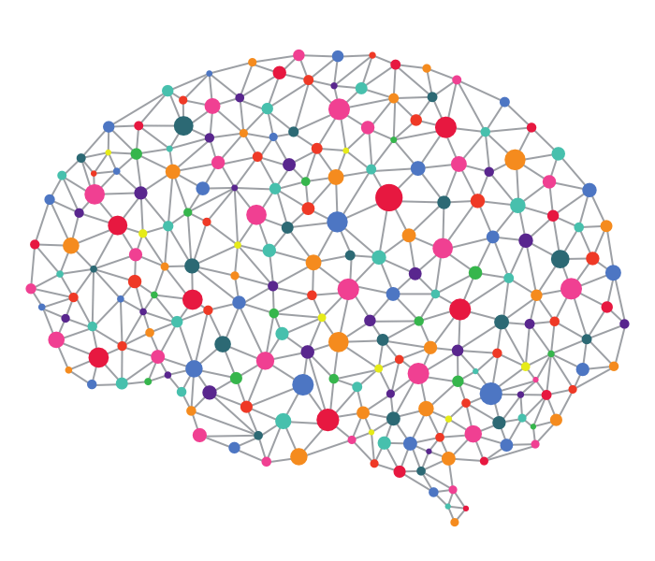
Case study: FallKi
Group 2 : Yash Uday Pisat | Sneha Khirwal | Ankita Shah

Slide 2
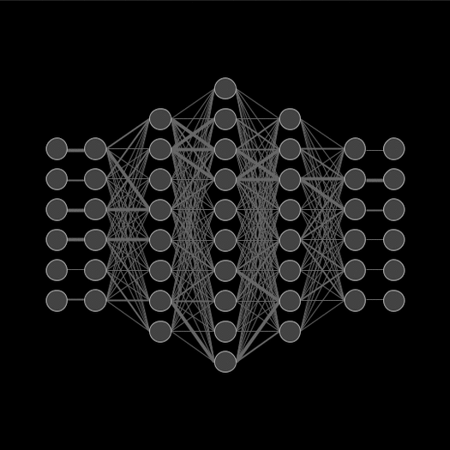





Agenda
Our Approach
Workflow Pipeline
Data pre-processing
Outlier Detection | Data Cleaning
Data Augmentation
Traditional | VAE | STFT
Cross Validation
4 different configurations
Metrics and Results
Confusion matrix | ROC & Precision Recall Curve

Slide 3
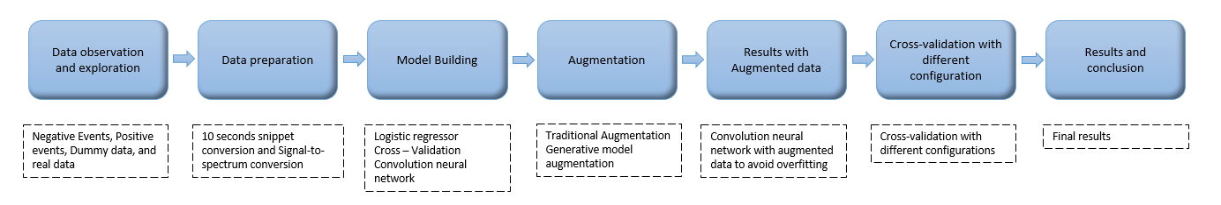
Workflow Pipeline
We built a pipeline to have a clear picture of how to proceed with each and every step of building, evaluating and enhancing the model for more efficient classification. Our case study was completed through several stages with the initial flow being the starting point.

Slide 4
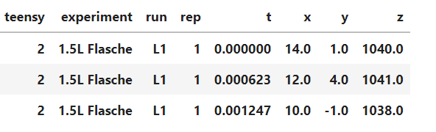
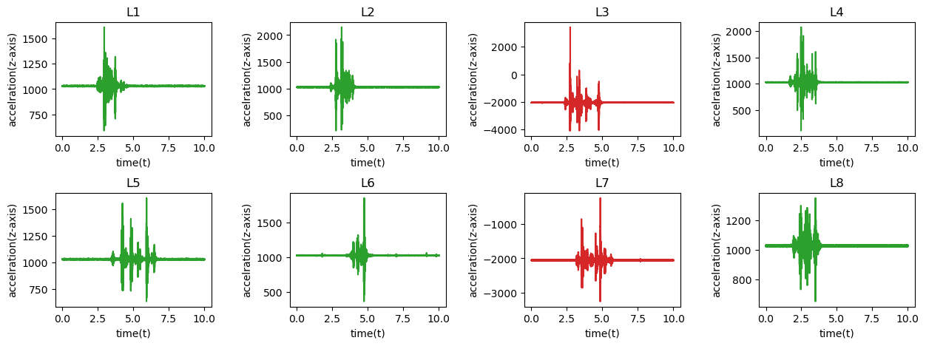
Data Pre-processing
Lab data
Outlier detection
Cleaned dummy data
The acceleration values(x,y,z) values at different settings and experiments for each of the sensors are obtained.
Incorrect data observed from the one of the faulty sensors for L3 and L7 settings
Cleaned data obtained after filtering out the negative values.

Slide 5
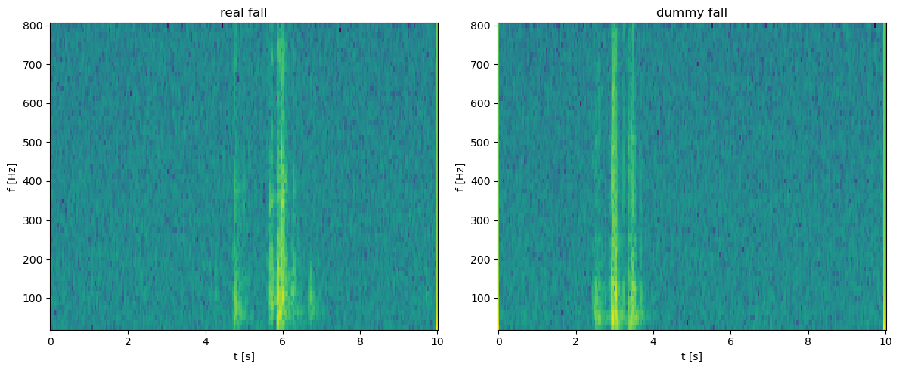
Real data exploration
Sensor data is converted in 10 second snippet
Short-time Fourier transform of 10 seconds snippets
Only 1 Real fall is identified and further implementation is done with dummy data

Slide 6
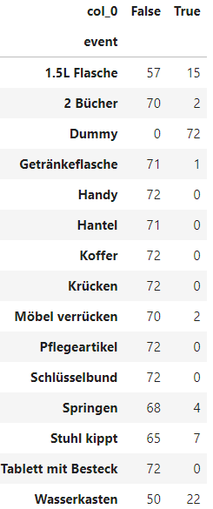
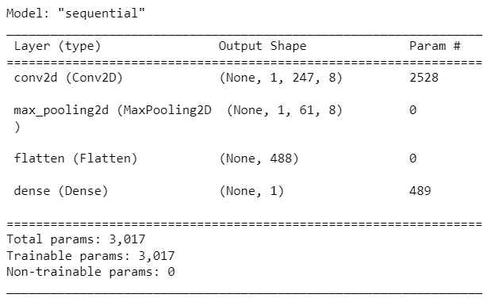
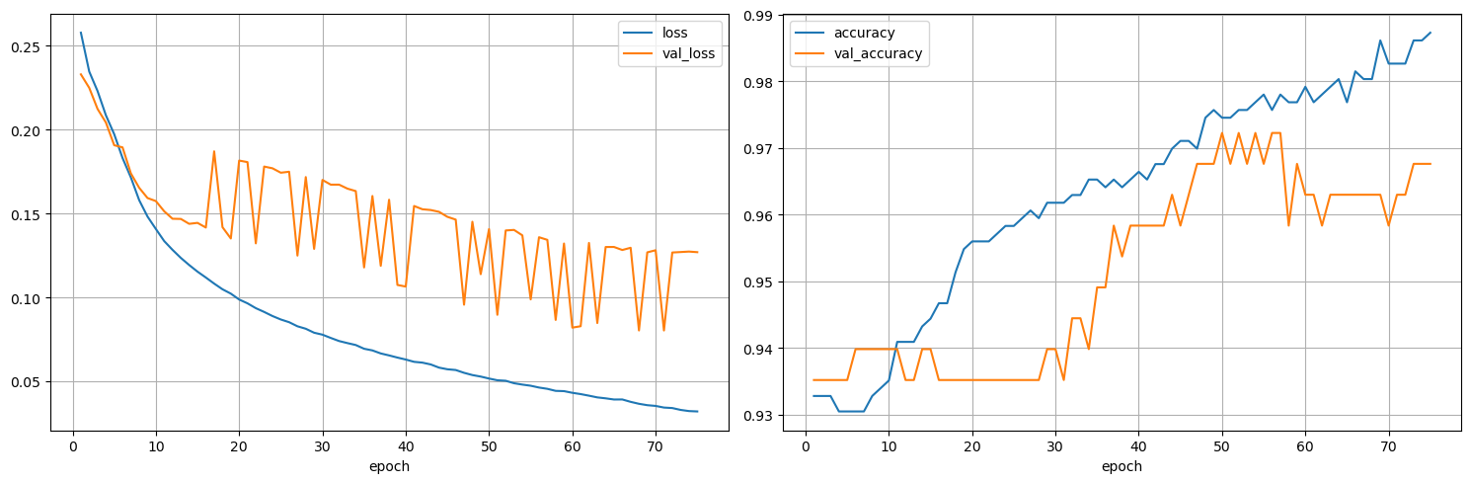
CNN - Overfitting
Since the data is imbalanced, Our CNN model is overfitting
Model accuracy is very high from the very beginning.
To reduce overfitting, we need more dummy data (class 1 data)
This can be achieved by implementation of several data augmentation techniques
Input data
(dummy + fake fall data)

Slide 7
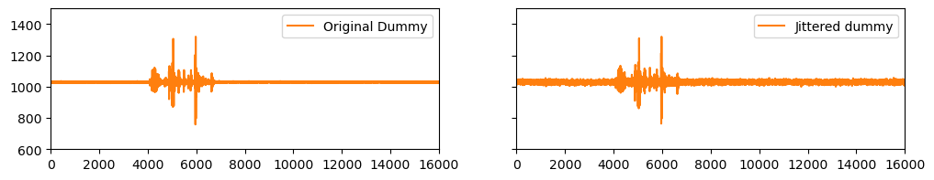
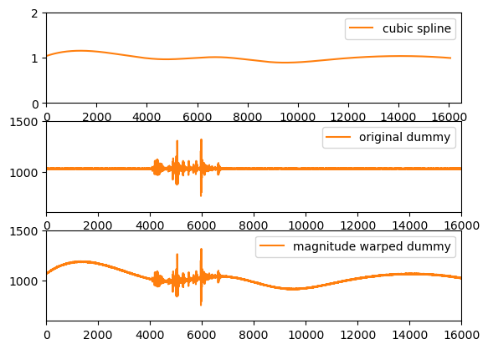
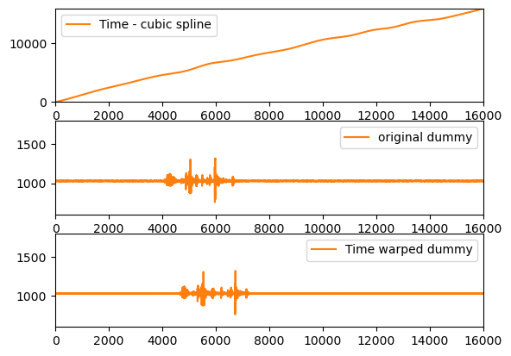
Traditional Augmentation methods
Jittering
Magnitude warping
Time warping

Slide 8
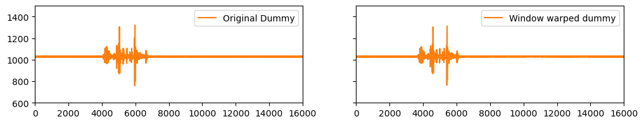
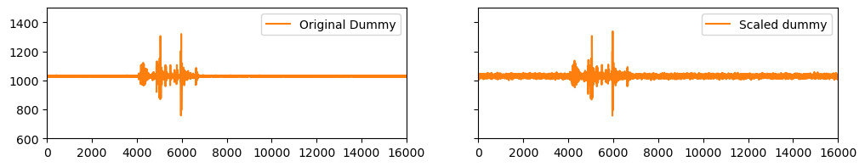
Traditional Augmentation methods
Window warping
Scaling

Slide 9
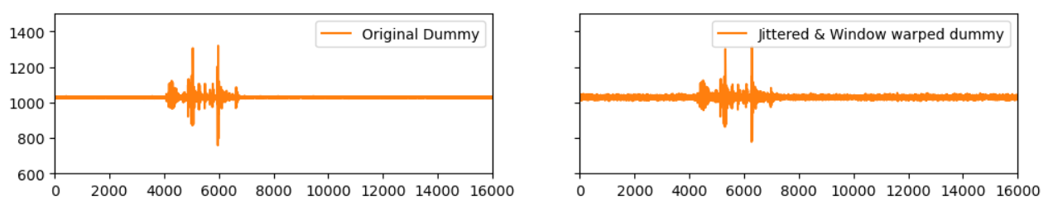
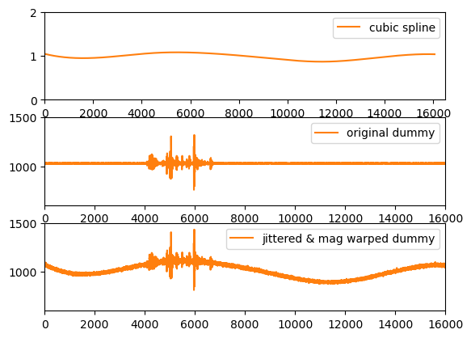
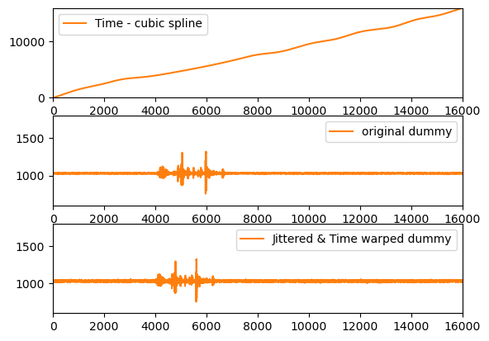
Combined traditional Augmentation methods
Jittering + window warping
Jittering + magnitude warping
Jittering + time warping

Slide 10
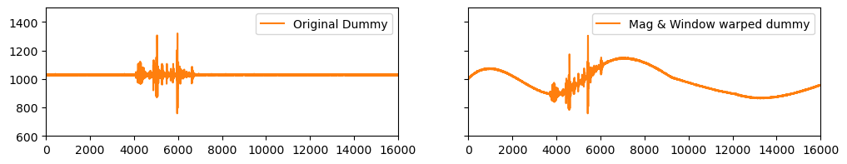
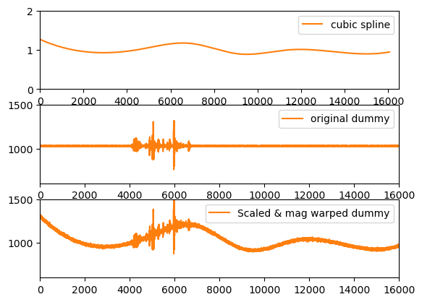
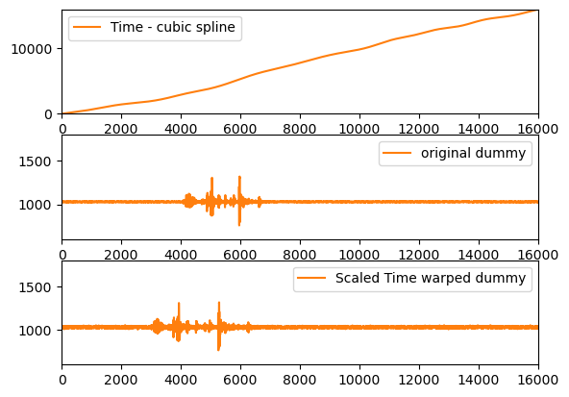
Combined traditional Augmentation methods
Magnitude + window warping
Scaling + magnitude warping
Scaling + time warping

Slide 11
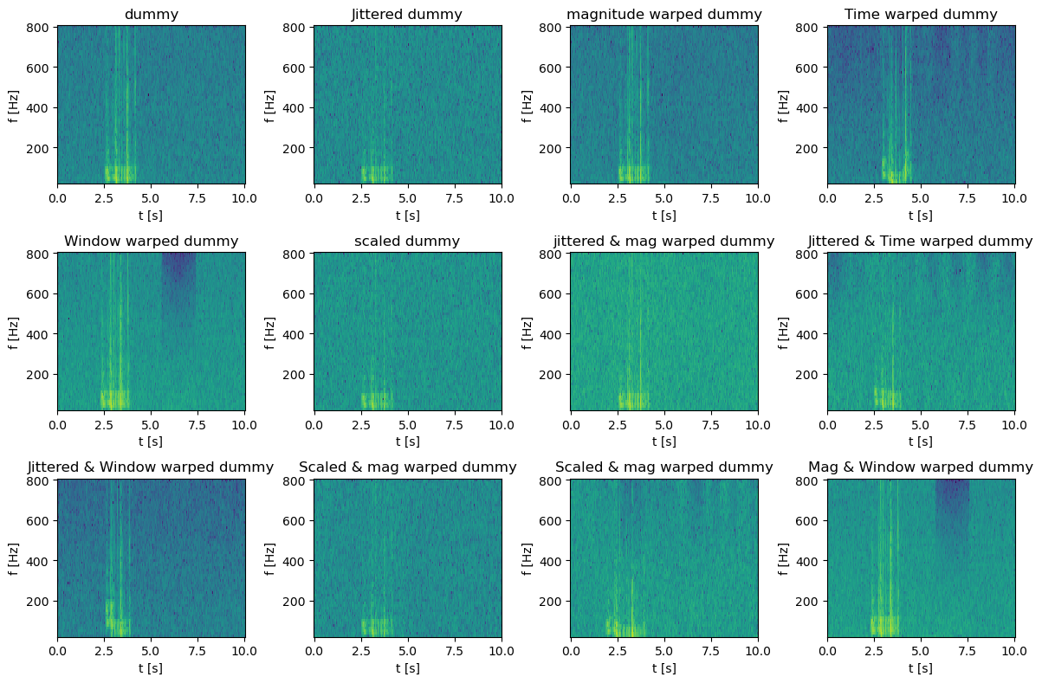
STFT plots

Slide 12
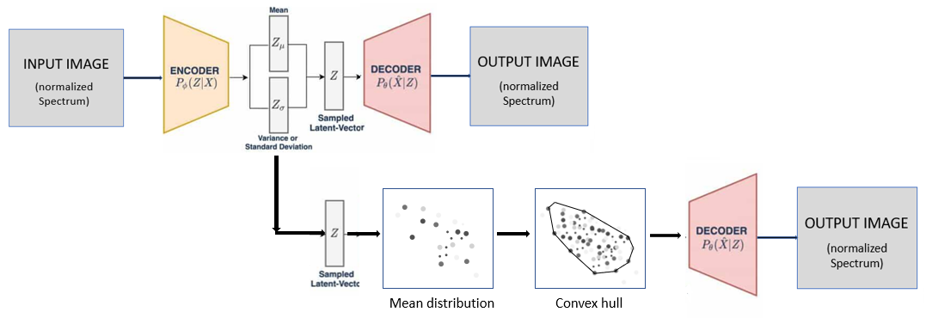
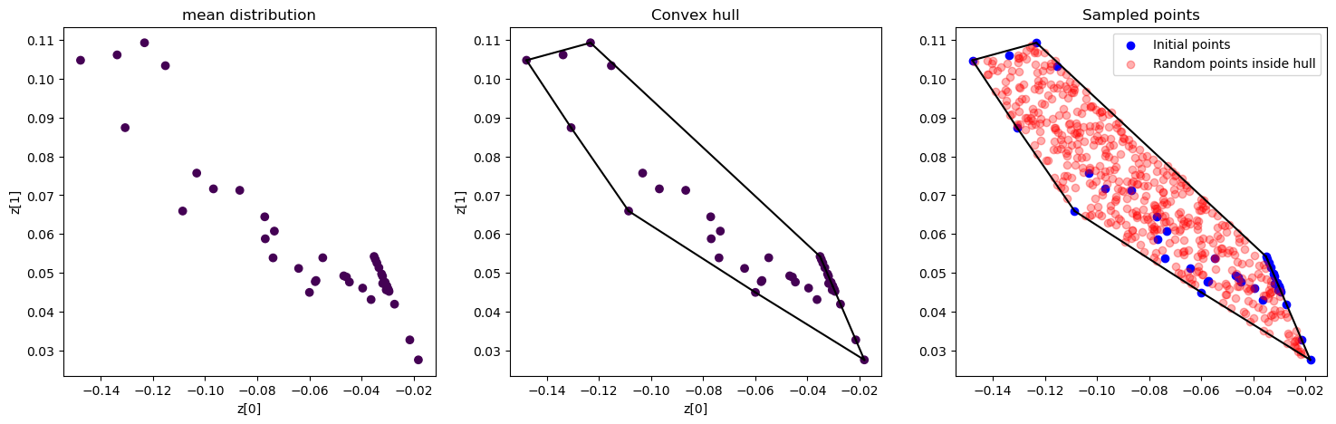
VAE
Encoder maps the input data(image) to a lower-dimensional representation
Latent space is defined by mean and standard deviation
Convex hull implementation for better sampling
Decoder maps the lower-dimensional representation back to the original data (image) space

Slide 13
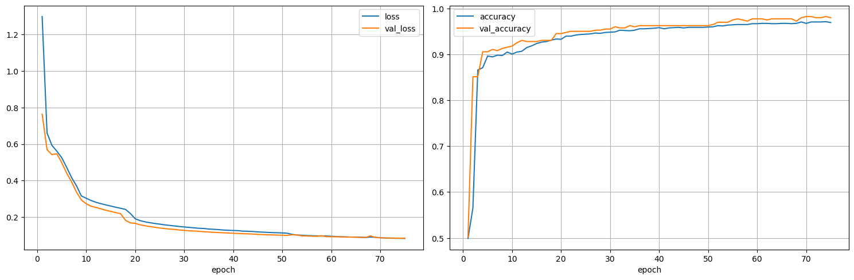
Training CNN (including augmented data)
Before
First pic shows the training and validation accuracy of previous overfitted model.
Now, CNN model is trained with all the dummy and other fall data with augmented data.
Unlike previous model, Accuracy starts from 50% and gradually increases 98%
Also, the training and validation loss reduces gradually with increasing epochs
Current

Slide 14
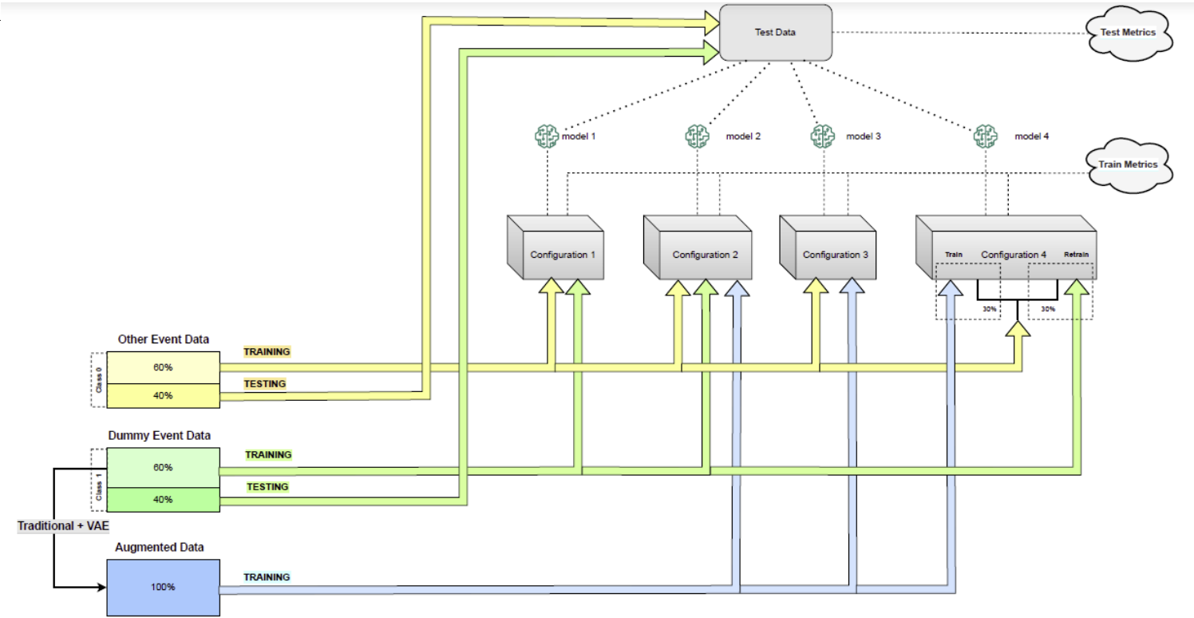
Cross Validation
Config 1: Other Event Data + Dummy Event Data
Config 2: Other Event Data + Dummy Event Data + Augmented Data
Config 3: Other Event Data + Augmented Data
Config 4 (Performed in two steps):
Train : 30% of Other Event Data
+ Augmented Data
Re-train: 30% of Other Event
Data + Dummy Event Data

Slide 15
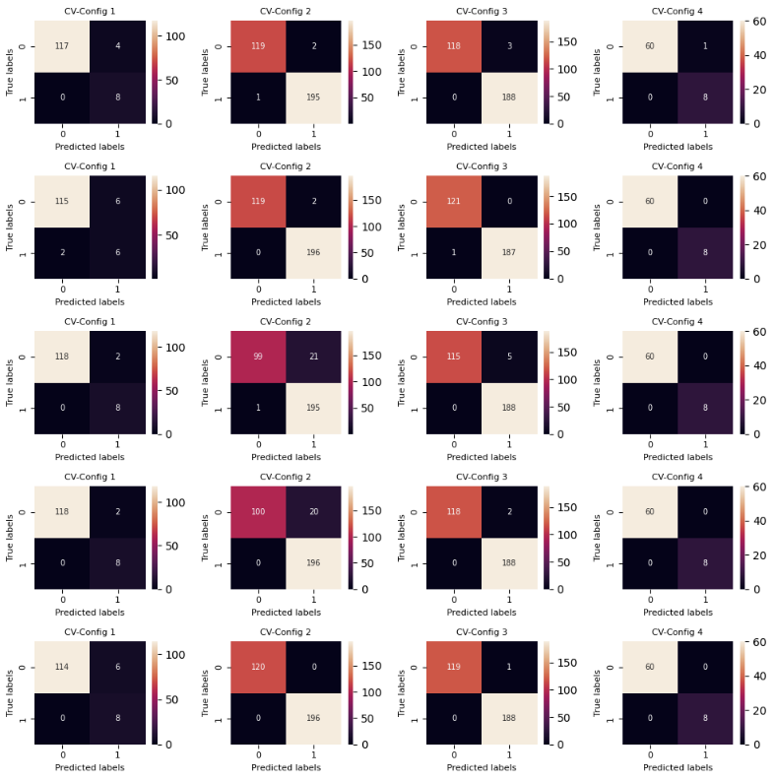
Confusion matrix
Metrics
Crucial to not miss any actual real fall.
Precision and recall are considered the most important metrics in such scenarios. Hence, ROC and precision-recall curve is chosen.
Comprehensive representation of the model's performance in confusion matrix

Slide 16
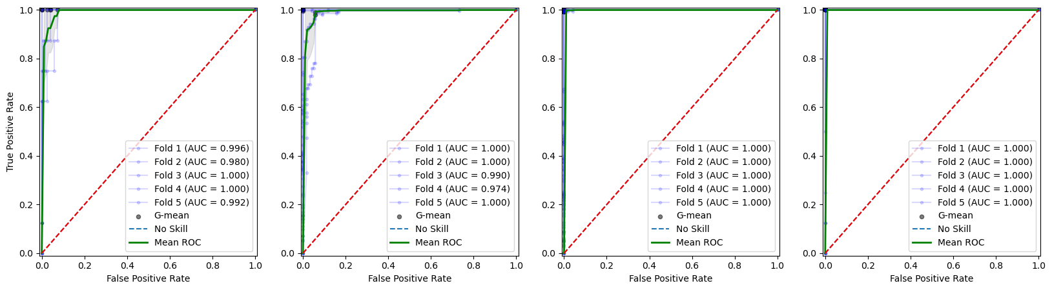
AUC – ROC Curve
ROC curve indicates how well the model can distinguish between classes.
The greater the AUC, the better the model predicts. AUC is highest for 3rd and 4th configuration.
Smaller values on the x-axis of the plot indicate lower false positives and larger values on y-axis indicate high true positive rate.

Slide 17
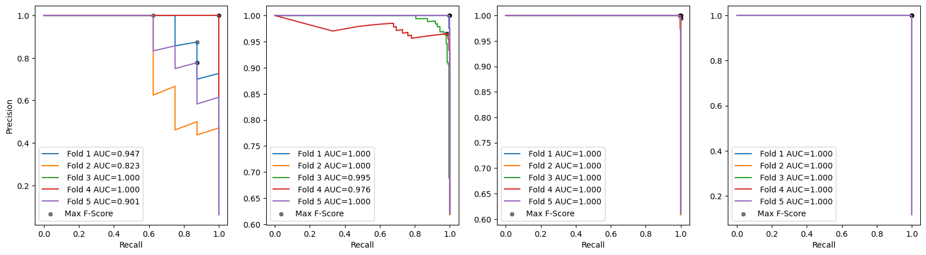
Precision – Recall Curve
A high precision indicates that the classifier makes very few false positive predictions
A high recall indicates that the classifier is able to detect most of the positive instances.
Area under the graphs increases with every configuration. For the 3rd and 4th configuration AUC is 1 for all the folds..

Slide 18
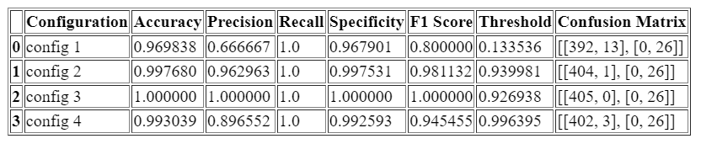
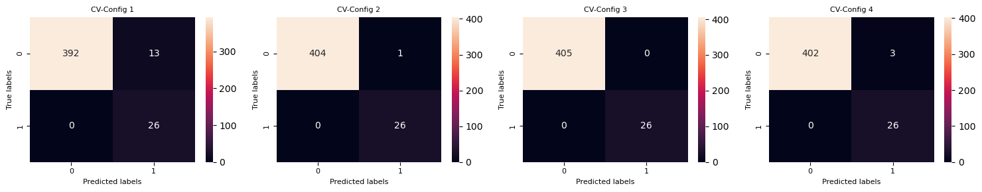
Prediction on test Data
The models obtained from the cross validation are used for predictions on the test data with the optimal thresholds where recall is 1(i.e lowest false negatives)and the above confusion matrices are plotted for visualization.
It can be observed that for all the configurations the mis-classification has reduced and specifically for configuration 3, both types of errors, false positives and false negatives have eliminated.

Slide 19
Conclusion and future work
Addressed overfitting and insufficient data through data augmentation techniques for improved performance.
Performed cross-validation to test the optimal training combination suitable for the model.
The configurations tested in this report can serve as a template for testing real fall data from a nursing home
Future work includes testing with real fall data and further optimization through hyperparameter tuning.
It is important to note that increasing the effect of traditional augmentation techniques may have a negative impact on the model's performance.

Slide 20
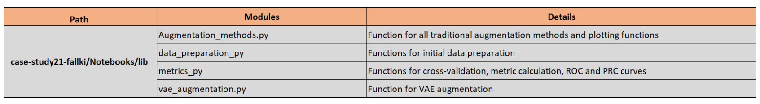
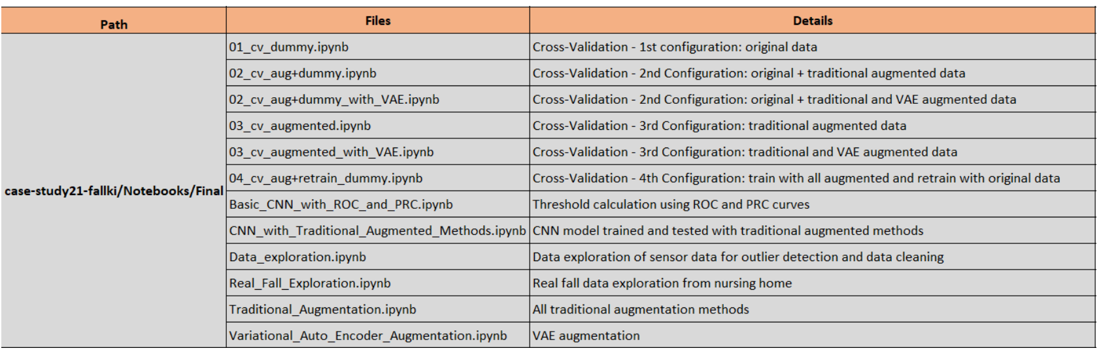
Appendix

